Slide 1
MAT 350 Engineering mathematics
System of First order ODEs
Lecture: 11
Dr. M. Sahadet Hossain (Mth)
Associate Professor
Department of Mathematics and Physics, NSU.

Slide 2
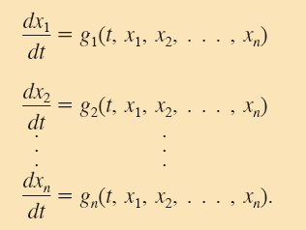
(1)
A system such as (1) of n first-order equations is called a first-order system.
When each of the functions g₁, g₂, . . . , g_{n} in (1) is linear
in the dependent variables x₁, x₂, . . . , x_{n}, we get the normal form of a first-order system of linear equations:

Slide 3
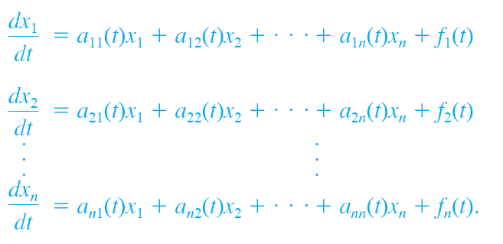
(2)
We refer to a system of the form given in (2) simply as a linear system. We assume that the coefficients a_{ij} as well as the functions f_{i} are continuous on a common interval I.
When f_{i}(t)= 0, for i= 1, 2, . . . , n, the linear system (2) is said to be homogeneous; otherwise, it is nonhomogeneous.

Slide 4
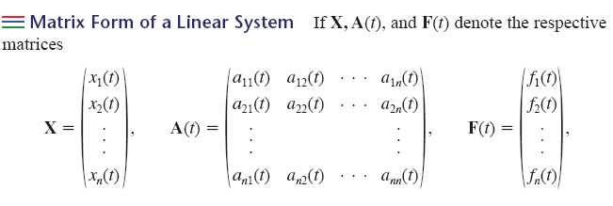
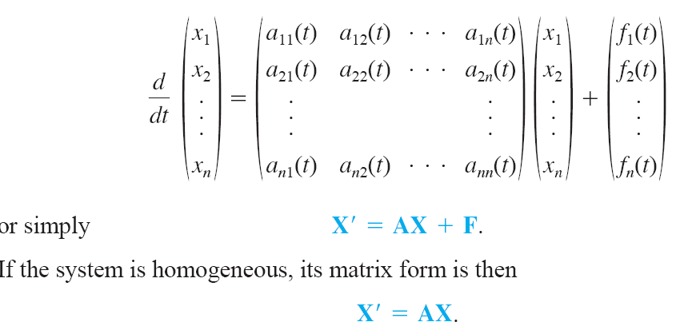
(3)
Then the system of linear first-order differential equations (2) can be written as
(4)
(5)

Slide 5
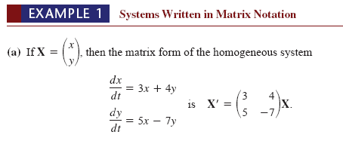
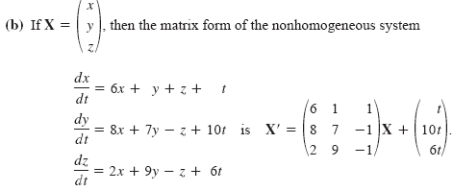

Slide 6
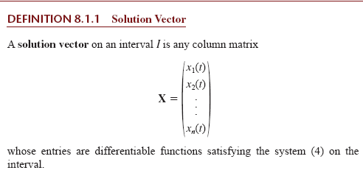
Note: The solution X is a vector. Hence, important properties applied to vectors, such as superposition principle, linear combination, linear independence/ dependence, etc., are also applicable here for X.

Slide 7
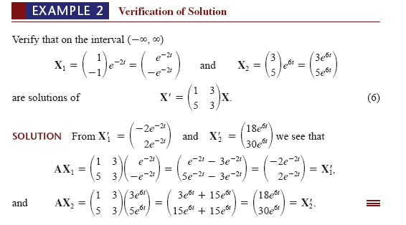

Slide 8
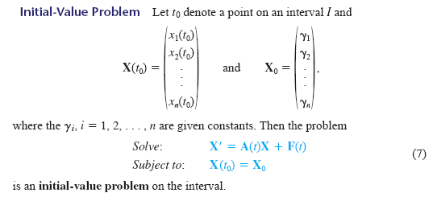
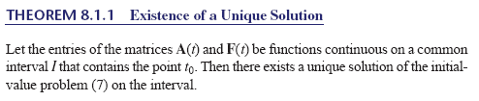

Slide 9
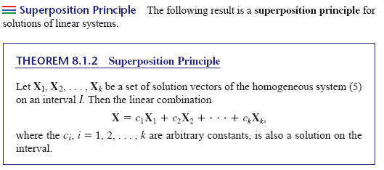

Slide 10
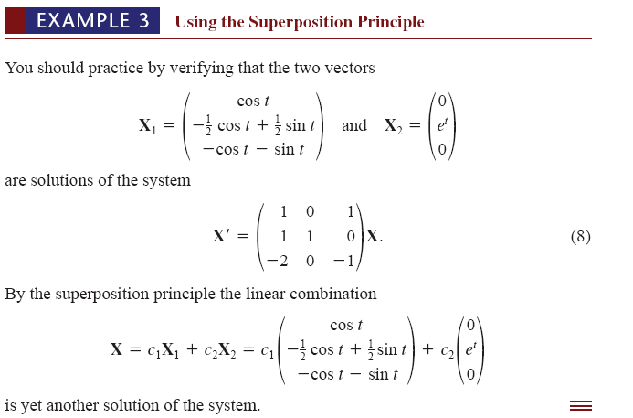

Slide 11
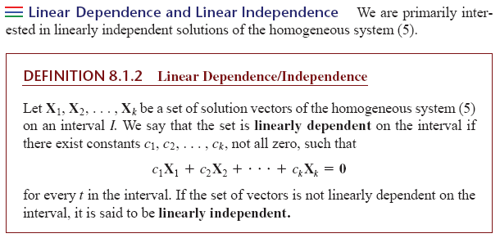

Slide 12
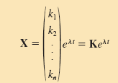



(1)
where,
(2)

Slide 13
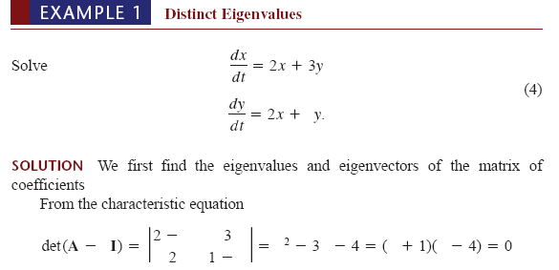
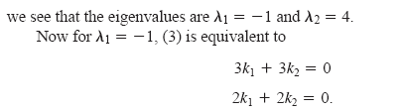
Continue-...........

Slide 14
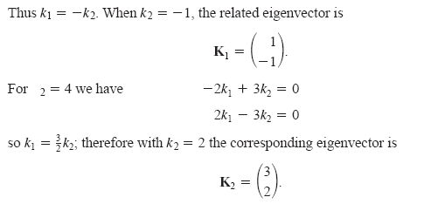
Continue-...........

Slide 15
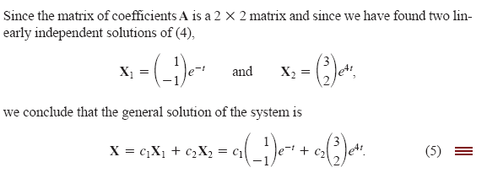

Slide 16
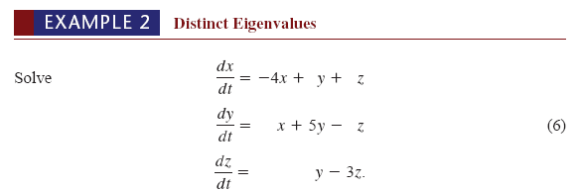
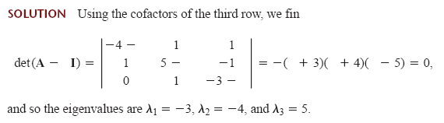

Slide 17
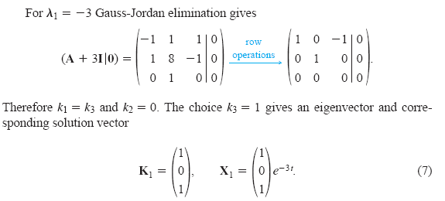

Slide 18
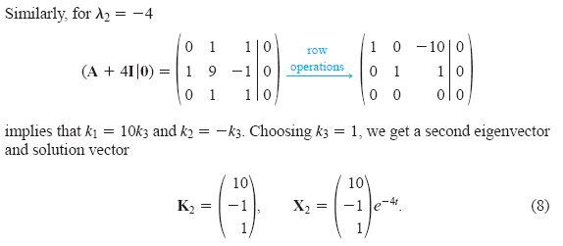

Slide 19
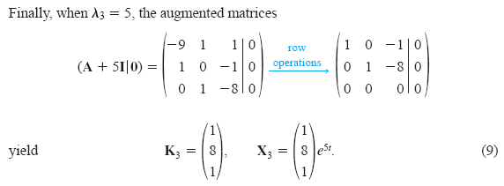
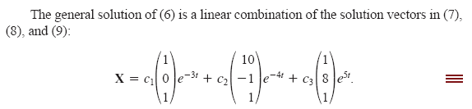

Slide 20

Homework

Slide 21

